Slide 1
266 Natural Language Processing
Week 11: Multimodality in NLP

Slide 2
This Week
Goals
Examine a variety of multimodal tasks and gain some intuition for the kinds of network structures used to approach them
Provide enough framework and context to independently explore these tasks and their relevant papers.
Non-Goals
Deep dive into any particular application.

Slide 3
Peeking Ahead
Week 1: Introduction
Week 2: Text Classification
Week 3: Language and Context
Week 4: Pretrained Transformers
Week 5: Text Generation Models
Week 6: Machine Translation
Week 7: Question Answering & Summarization
Week 8: Linguistic Representation
Week 9: Entities and Linking
Week 10: Embedding-based Retrieval
Week 11: Multimodality in NLP
Week 12: ML Fairness and Privacy
Week 13: NLP in the Real World

Slide 4
Announcements
Reminder: No Class next week (Spring Break)
Assignments
A4 Due Sunday 03/24 (Tuesday 03/26 if you use late days)
Final assignment
Project
Projects - Due Saturday 04/14 (hard deadline)
Optional milestone - 03/18
3 - 4 WEEKS
Questions?
Concerns?

Slide 5
Announcements
Paper reading sessions:
LLM Efficiency Crash Course
memory efficiency: quantization: LLM.int8(): 8-bit Matrix Multiplication for Transformers at Scale
model inference efficiency: SPEED: Fast Inference from Transformers via Speculative Decoding
system level inference efficiency: Flash-decoding for long-context inference
Peter: Tuesday 03/19 Noon PST
How to Write a Project Paper
Mark: Tuesday 4/2 5:30 pm PST
Concerns?

Slide 6
The Plan
Structure of Class
Project Check in
Key Learning Review
Multimodal
Image captioning
Captioning parts regions of images
Visual Question Answering
Text-Conditional Image Generation (DALL-E 2)
Multimodal LLMs

Slide 7
Project check-In
Who has their data? (hopefully, everybody)
Who has a baseline? (hopefully, everybody)
Experiments to improve baseline? (hopefully several)
Analysis?
Why is the model performing as is?
What are unexpected results and why are they occurring?
Idea for finding unexpected: randomly sample places where the model and the label disagree.
Problems?
Some example model analysis is shown in this notebook

Slide 8
Key Learnings Review
Multimodality in NLP

Slide 9
NLP Review
Describe the coreference resolution problem? What is a technique to approach it?
NDCG is a common metric for information retrieval. What motivated the inclusion of “N”? “D”?
Why might factoring a model into two towers result in lower model performance?

Slide 10
Image Captioning
Multimodality in NLP

Slide 11
Approach 1: Show and Tell
Train a state of the art image classifier
Remove the classification head
Append a LSTM, connecting the CNN representation to the input state vector
Holding the CNN parameters fixed, train the LSTM to predict the correct sequence of words
a
bike
<e>
Cell
Cell
Cell
Cell
<s>
a
bike
Why start with a image classifier trained on imagenet instead of just training the whole model end to end?
Why hold the CNN parameters fixed?
Beam search dramatically improves the quality of generated text. When the beam width is 1, what is this equivalent to? What about if the beam width is infinite?
Final hidden layer
Convolutional NN over an image
Show and Tell: A Neural Image Caption Generator (https://arxiv.org/pdf/1411.4555.pdf)
Notes:
Not enough data to train the whole network e2e on just MS COCO. Transfer learn quality image representations from imagenet models.
Again, too many parameters to train.
inf: exhaustive

Slide 12
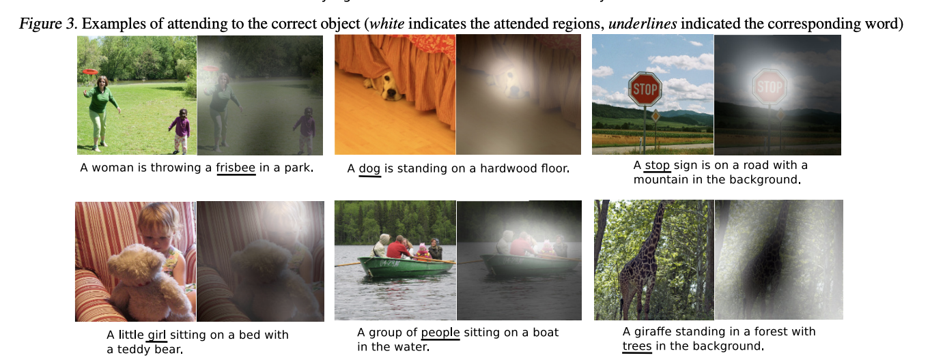
Approach 2: Show, Attend and Tell
a
bike
<e>
Cell
Cell
Cell
<s>
a
bike
Attention
Annotation vectors
Where do the annotation vectors come from?
How do they enable the attention highlighting (e.g. in figure 3 above)?
Convolutional NN over an image
Layers of Feature Maps
Show, Attend and Tell: Neural Image Caption Generation with Visual Attention (https://arxiv.org/pdf/1502.03044.pdf)
Notes:
They are pulled from lower levels of the CNN
Attention to a particular annotation vector implies attention to the portion of the image corresponding to the receptive field of that vector.

Slide 13
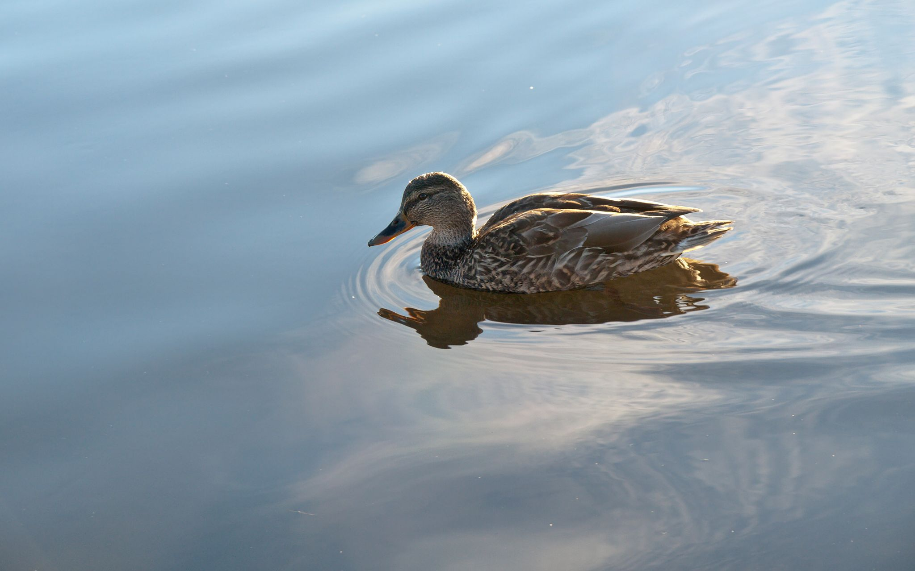
Annotation vectors, visualized
Each layer of the CNN has multiple feature maps (one per kernel at that layer)
Using all the values in the same position across the feature maps generates a vector gives a representation of what is present in the image at that location.
We’ll call each of these vectors an “annotation vector”, a_{i}.
(multiplied by n kernels at this layer)
Annotation vector corresponding to upper left corner of image

Slide 14
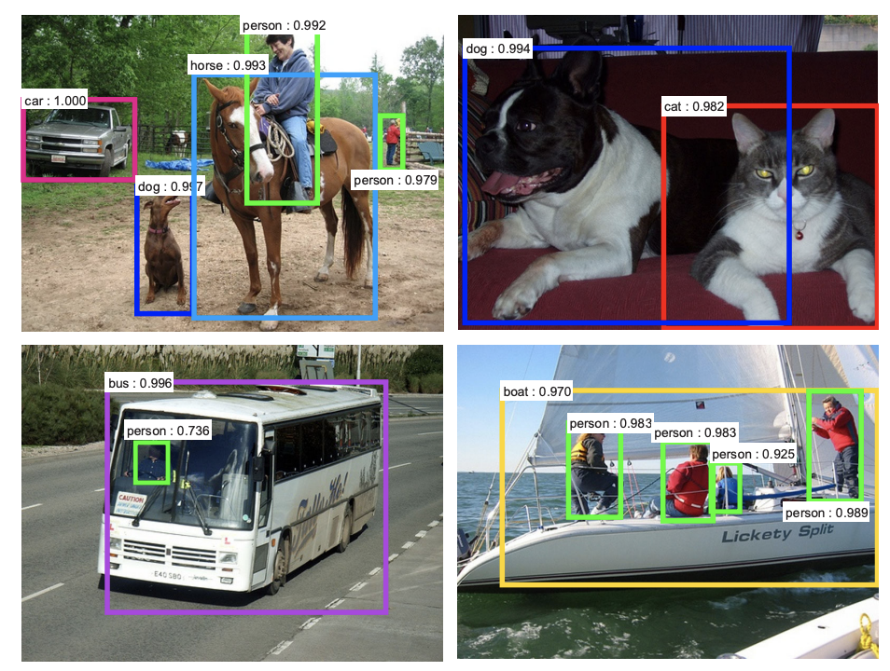
Images with multiple parts
What are two approaches for labeling images composed of multiple objects?
In either case, how would you decompose the modeling challenge?
Notes:
Categorical (similar to image net) or free form text generation (image captioning of image regions)
(1) Propose regions to label; (2) generate label

Slide 15
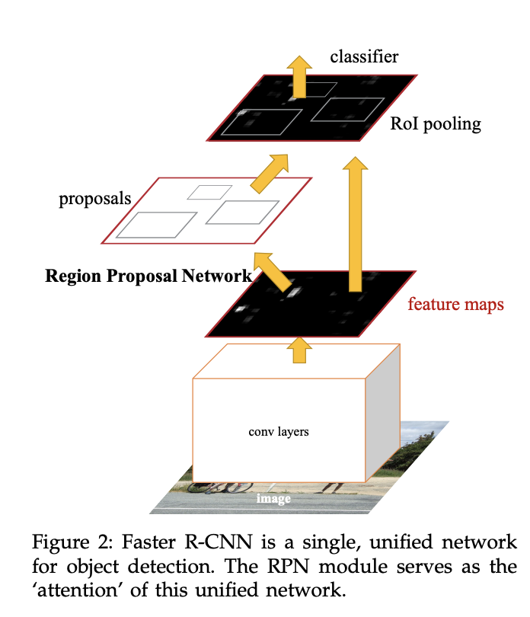
Region Proposal Networks
RPNs propose regions of an image that each likely contain an object.
Each region can then be separately classified
Sharing compute between the region proposal and the classification is common (remember, feature maps align spatially with the underlying image)
Faster R-CNN: Towards Real-Time Object Detection with Region Proposal Networks (https://arxiv.org/pdf/1506.01497.pdf)

Slide 16
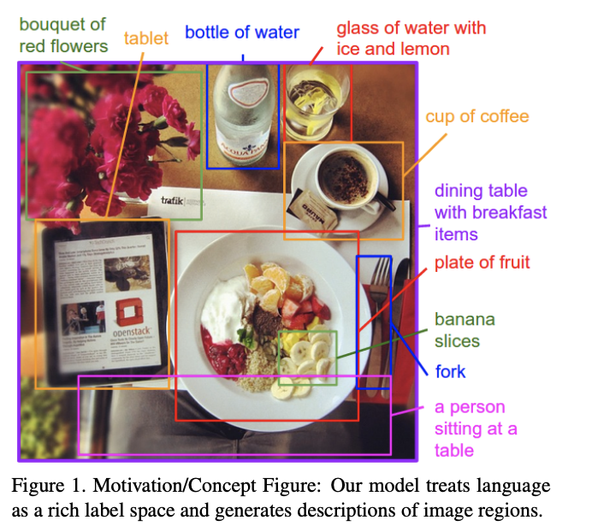
Alignments for … Image Descriptions
Classification of the regions doesn’t need to be done by a fixed set of classes
Instead, once regions have been proposed, each can be considered their own image and captioned using natural language
Deep Visual-Semantic Alignments for Generating Image Descriptions (https://arxiv.org/pdf/1412.2306.pdf)

Slide 17
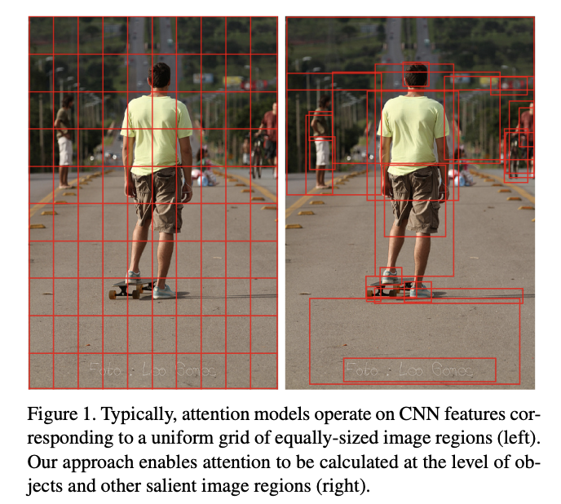
Using regions as the unit of attention
Attention in “Show, Attend and Tell” used vectors corresponding to some fixed dimension regions of the image.
What if we augmented this with the representations of regions proposed by a RPN?
Bottom-Up and Top-Down Attention for Image Captioning and Visual Question Answering (https://arxiv.org/pdf/1707.07998.pdf)

Slide 18
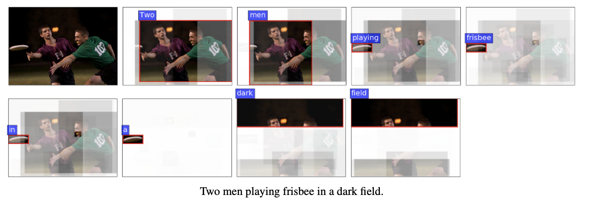

Slide 19
Visual Question Answering
Multimodality in NLP
How is this different from regular question answering?
Notes:
Regular question answering: given a passage of text and a textual question, (A) can you answer the question? (B) if so, what is the answer; in VQA, the question is asked in natural language about an image instead of a textual passage

Slide 20
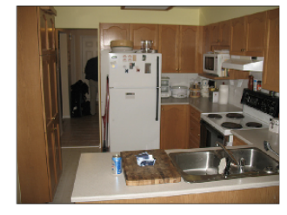
Visual Question Answering
Input consists of two components:
An image
A question about the image
“What room are they in?”
What is output from these models?
Notes:
Often a selection from one of k classes (each representing an answer). Often an attention mechanism provides context as to why the network answered in the way that it did. (See next slide)

Slide 21
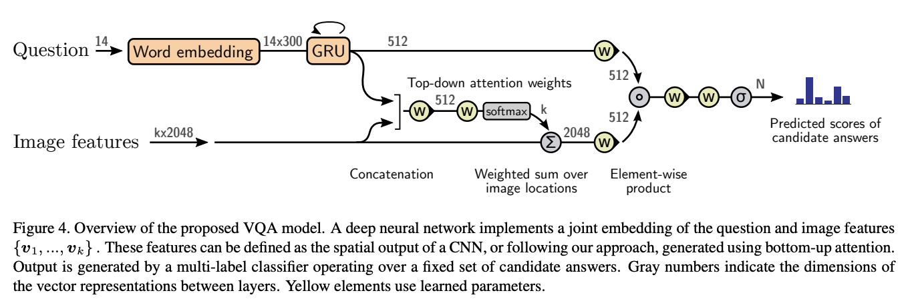
Visual Question Answering
Bottom-Up and Top-Down Attention for Image Captioning and Visual Question Answering (https://arxiv.org/pdf/1707.07998.pdf)

Slide 22
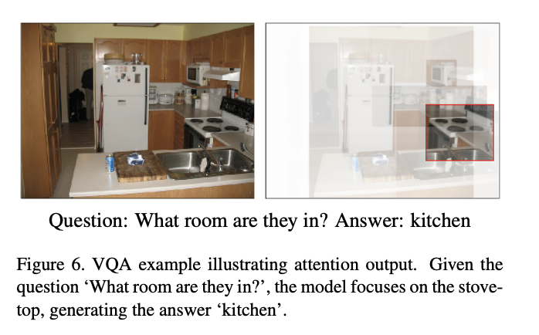
Visual Question Answering: output
Bottom-Up and Top-Down Attention for Image Captioning and Visual Question Answering (https://arxiv.org/pdf/1707.07998.pdf)

Slide 23
Text-conditional Image Generation
Multimodality in NLP

Slide 24

Teaser: DALL-E 2
A bowl of soup that is a portal to another dimension as a digital art

Slide 25
Image Generation
Two steps:
Better image understanding / representation using large scale semi-supervised natural language
Take advantage of the natural language connection to generate compelling images based on text prompts
Fundamental contribution: CLIP.
Learning Transferable Visual Models From Natural Language Supervision (https://arxiv.org/pdf/2103.00020.pdf)

Slide 26
CLIP: Contrastive Language-Image Pre-training
Critical insight that yielded large language models was that massive semi-supervised/masked lower-quality data was vastly superior to smaller high quality data sets
Can we do the same for image representations?
Maybe!
But … existing datasets are too small (MSCOCO and Visual Genome 100k each, YFCC100M only has 15M natural language captions)
Learning Transferable Visual Models From Natural Language Supervision (https://arxiv.org/pdf/2103.00020.pdf)

Slide 27
CLIP: Contrastive Language-Image Pre-training
Dataset
Construct a 500k query list from:
popular terms on Wikipedia
bigrams with high mutual information
Higher search query volume Wikipedia article titles
Pull up to 20k (text, image) pairs from the results of each of those queries
Result: 400M (text, image) pairs with approximately the same word count as what was used to train GPT-2
Learning Transferable Visual Models From Natural Language Supervision (https://arxiv.org/pdf/2103.00020.pdf)

Slide 28
CLIP: Contrastive Language-Image Pre-training
Model Setup
Speed is of the essence with that much data!
Started with image captioning task, predicting exact text. Too slow (too much compute for too little model improvement).
Contrastive approach: instead of predicting words, make the network play a matching game. In a batch of N (text, image)s, determine which of the NxN pairings actually occurred. Loss function encouraged cosine similarity of correct text-image pairs, discouraged it for the N² - N others.
Learning Transferable Visual Models From Natural Language Supervision (https://arxiv.org/pdf/2103.00020.pdf)

Slide 29
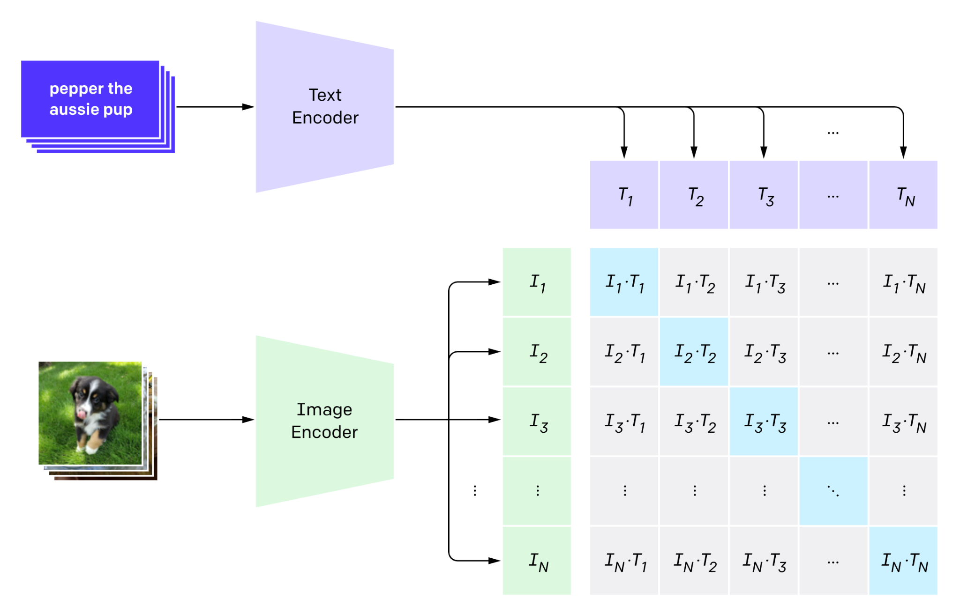
CLIP: Contrastive Language-Image Pre-training
Contrastive approach: instead of predicting words, make the network play a matching game. In a batch of N (text, image)s, determine which of the NxN pairings actually occurred. Loss function encouraged cosine similarity of correct text-image pairs, discouraged it for the N² - N others.
Learning Transferable Visual Models From Natural Language Supervision (https://arxiv.org/pdf/2103.00020.pdf)

Slide 30
CLIP: Contrastive Language-Image Pre-training
Model Structure
Image encoding
ResNets-D (profitable image classification architecture) of various shapes
ViT (Visual Transformers - transformers that use small patches of image as tokens)
Text encoding
Average CBOW embedding
Transformer models
Final CLIP: ViTs w/ text transformers
Learning Transferable Visual Models From Natural Language Supervision (https://arxiv.org/pdf/2103.00020.pdf)

Slide 31
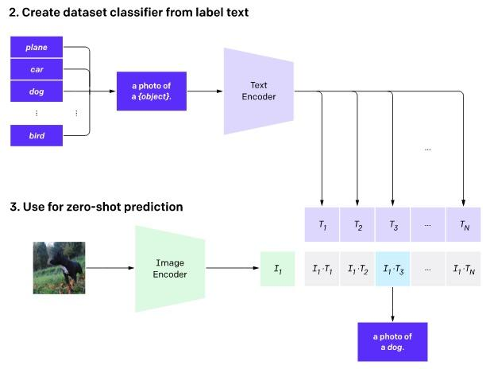
CLIP: Zero Shot Image Classification
Use CLIP embeddings to create a zero-shot classifier. Given an image and a set of captions use softmax to assign probabilities that each caption goes with the image
Learning Transferable Visual Models From Natural Language Supervision (https://arxiv.org/pdf/2103.00020.pdf)

Slide 32
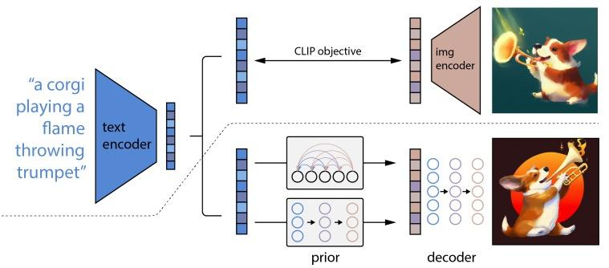
Image Decoder and Rendering
Above dotted line is the CLIP pre-training. Below is CLIP text encoder generates text embedding for autoregressive or diffusion
prior to produce an image embedding, which is used to condition a diffusion decoder to produce a final image.
Source: Hierarchical Text-Conditional Image Generation with CLIP Latents

Slide 33
Image Interpolation
DALL-E: Easy to find two vectors to interpolate between on the kind of change you want. Simply write two sentences with the desired contrast!
GAN: Harder (but still possible!) to find a direction in vector space to adjust the input to change the output (i.e. adjust a face to be more masculine or feminine)
In both frameworks, you can interpolate the output image between two outputs by interpolating between input representations in vector space.
Hierarchical Text-Conditional Image Generation with CLIP Latents (https://arxiv.org/pdf/2204.06125.pdf)

Slide 34
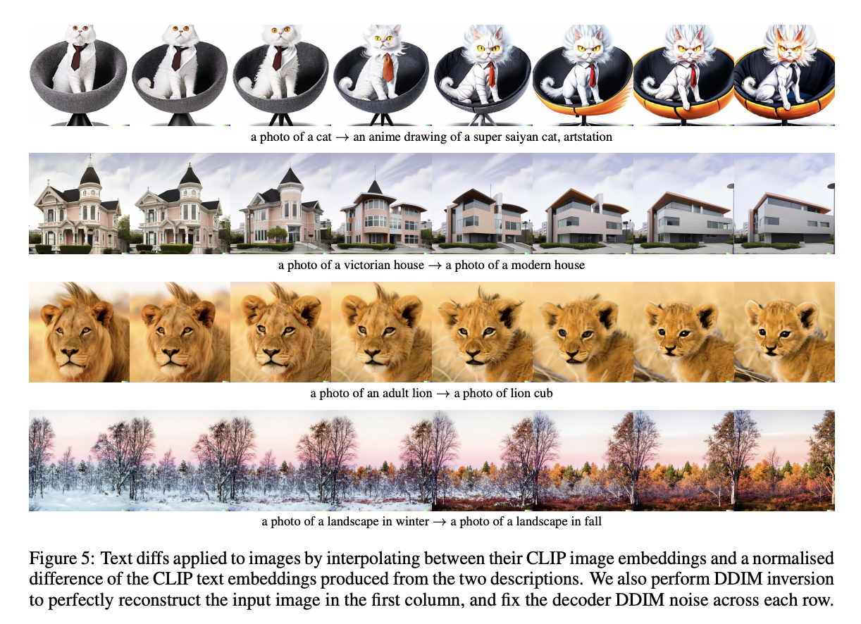
DALL-E: Interpolation
Interpolation example.
Highly recommend skimming the paper for other really interesting perturbations the authors performed.
Hierarchical Text-Conditional Image Generation with CLIP Latents (https://arxiv.org/pdf/2204.06125.pdf)

Slide 35
Playground
DALL-E Mini
Notes:
Sample prompts with and without ambiguity and typos: “a fish with a bow tie and bowler”, “a fish wearing a bow tie and bowler”, “a fish riding a bicycle with a bow tie and bowler”, “a fish riding a bicycle wearing a bow tie and bowler”, “a fish wearing a bow tie and bowler and riding a bicycle”, “a corgi wearing a bowler and bow tie”, “a dacshund wearing a bowler and bow tie”, “a bernese wearing a bowler and bow tie in the big city”, “a bernese wearing a bowler and bow tie in the mountains”

Slide 36
Playground
Stable Diffusion
Notes:
Sample prompts with and without ambiguity and typos: “a fish with a bow tie and bowler”, “a fish wearing a bow tie and bowler”, “a fish riding a bicycle with a bow tie and bowler”, “a fish riding a bicycle wearing a bow tie and bowler”, “a fish wearing a bow tie and bowler and riding a bicycle”, “a corgi wearing a bowler and bow tie”, “a dacshund wearing a bowler and bow tie”, “a bernese wearing a bowler and bow tie in the big city”, “a bernese wearing a bowler and bow tie in the mountains”

Slide 37
Paper Peeks/Recent Advances/Challenges
Multimodality in NLP

Slide 38
Extras
Multimodality in NLP

Slide 39
Evaluation
Multimodality in NLP

Slide 40
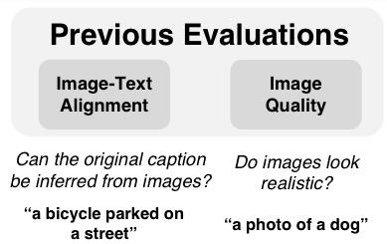
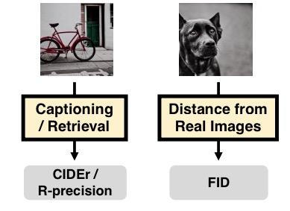
DALL-Eval
How Do We Measure:
Image Quality: Use existing image classifier to label the realism of the output
Image-Text Alignment: use BLEU to compare prompt with a caption generated based on image
DALL-EVAL: Probing the Reasoning Skills and Social Biases of Text-to-Image Generative Models(https://arxiv.org/pdf/2204.04053.pdf)

Slide 41
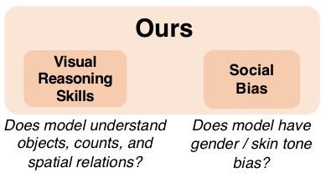
DALL-Eval
Better Measures:
Object Recognition
Object Counting
Spatial Relation Understanding
Gender Bias
Skin Tone Bias
PAINTSKILLS Data Set
Compositional Diagnostics
Evaluation Toolkit
DALL-EVAL: Probing the Reasoning Skills and Social Biases of Text-to-Image Generative Models(https://arxiv.org/pdf/2204.04053.pdf)

Slide 42
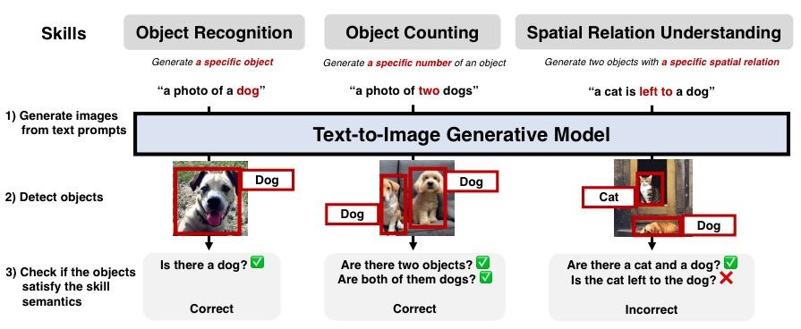
DALL-Eval: Visual Reasoning
PAINTSKILLS image examples
DALL-EVAL: Probing the Reasoning Skills and Social Biases of Text-to-Image Generative Models(https://arxiv.org/pdf/2204.04053.pdf)

Slide 43
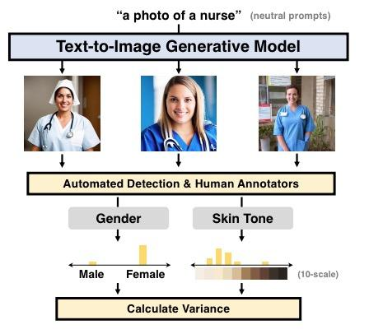
DALL-Eval: Social Bias
Neutral prompt generates 9 images
Automatically classify binary gender with CLIP
Automatically measure skin tone
Measure variance in distribution to assess bias
DALL-EVAL: Probing the Reasoning Skills and Social Biases of Text-to-Image Generative Models(https://arxiv.org/pdf/2204.04053.pdf)

Slide 44
Audio Playground
AudioLM Demo

Slide 45
Imagen and Parti

Slide 46
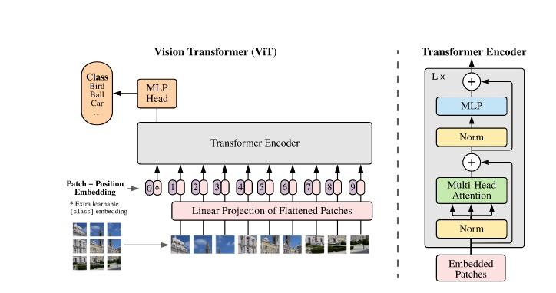
Vision Transformers
Source: An Image is Worth 16x16 Words

Slide 47
Multimodal Large Language Model (MLLM)
Multimodality in NLP

Slide 48
Multimodal Large Language Model (MLLM)
MLLMs combine text with other kinds of information, such as images, videos, audio, and other sensory data.
Multimodality can unlock new applications that were impossible with text-only LLMs. e.g., describing images and videos or generating commands for robots.
MLLMs use modules that encode not just text but other types of data into the same encoding space. This enables the model to compute all kinds of data through a single mechanism.
Examples: Kosmos-1, PaLM-E, GPT-4

Slide 49
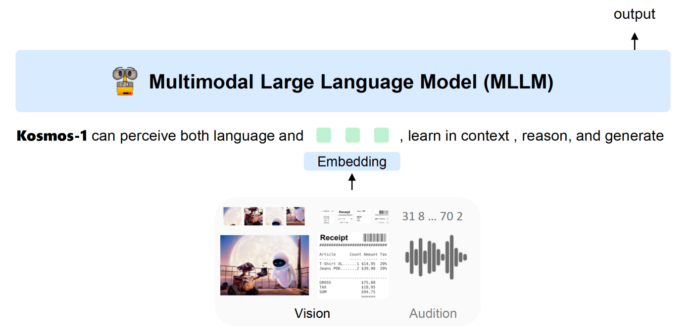
KOSMOS-1
Figure 1: KOSMOS-1 is a multimodal large language model (MLLM) that is capable of perceiving multimodal input, following instructions, and performing in-context learning for not only language tasks but also multimodal tasks. In this work, we align vision with large language models (LLMs), advancing the trend of going from LLMs to MLLMs
Source: Language Is Not All You Need: Aligning Perception with Language Models

Slide 50
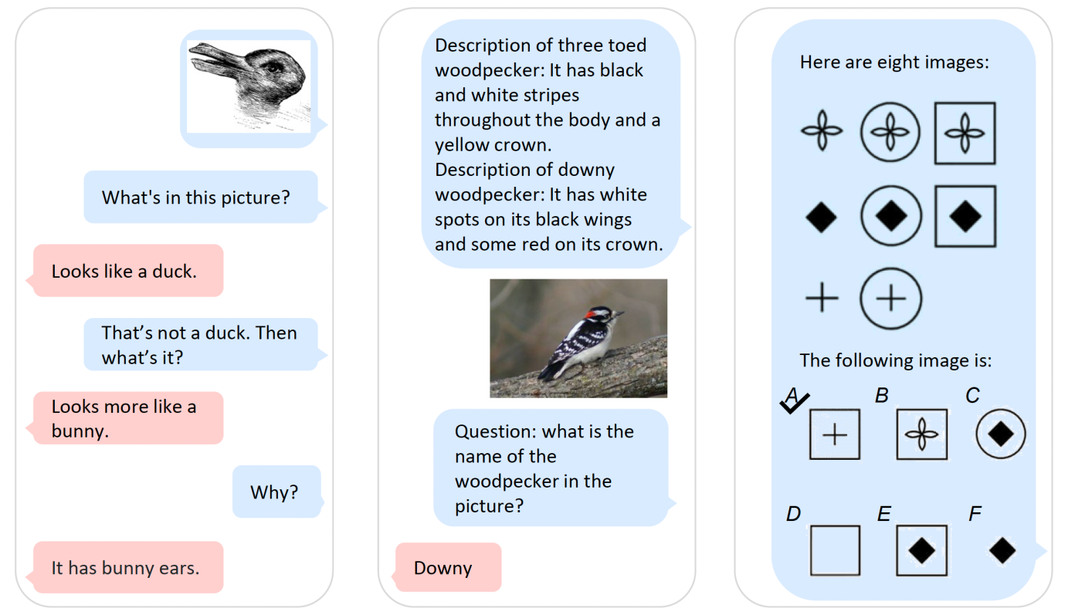
Examples of tasks by Kosmos-1
Source: Language Is Not All You Need: Aligning Perception with Language Models

Slide 51
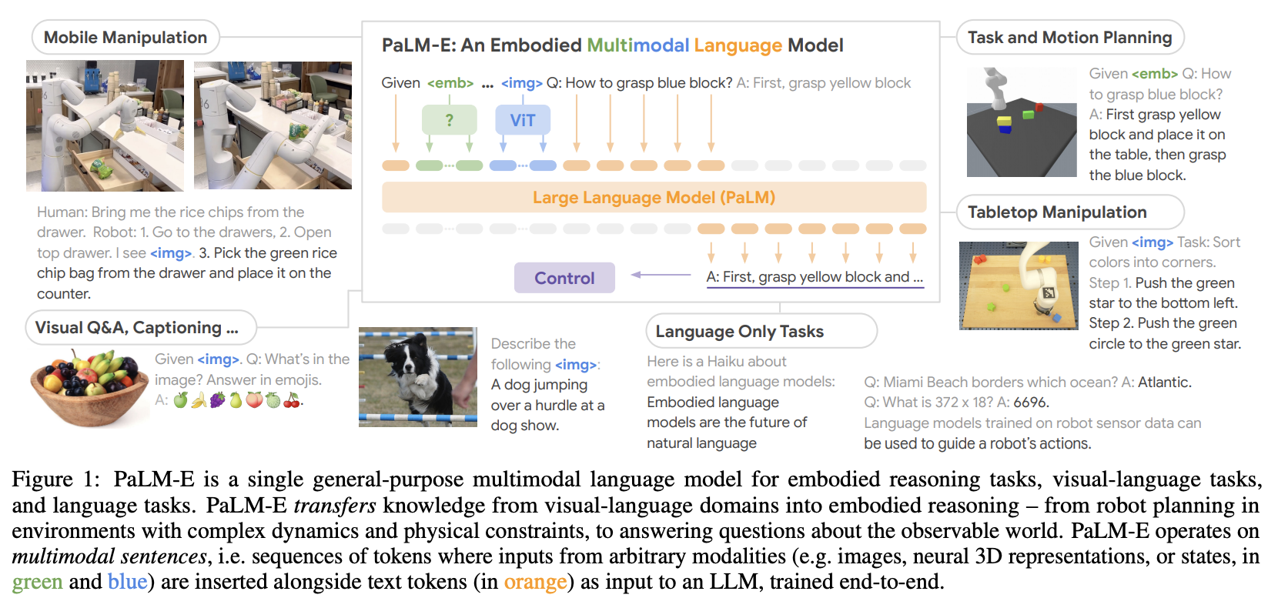
PaLM-E: An Embodied Multimodal Language Model
Source: PaLM-E: An Embodied Multimodal Language Model

Slide 52
GPT-4
GPT-4 is the successor of GPT-3.5, which powered ChatGPT.
GPT-4 has 1.8 trillion parameters, which is 10 times more than the model used in ChatGPT.
It also has access to a larger and more diverse dataset of 1 petabyte, which includes web texts, books, news articles, social media posts, code snippets, and more.
OpenAI reported that GPT-4 outperforms GPT-3 on several natural language understanding (NLU) and natural language generation (NLG) metrics such as BLEU, ROUGE, etc.

Slide 53
Diffusion Generators
Multimodality in NLP

Slide 54
CLIP: Contrastive Language-Image Pre-training (Radford et al 2021)

Slide 55
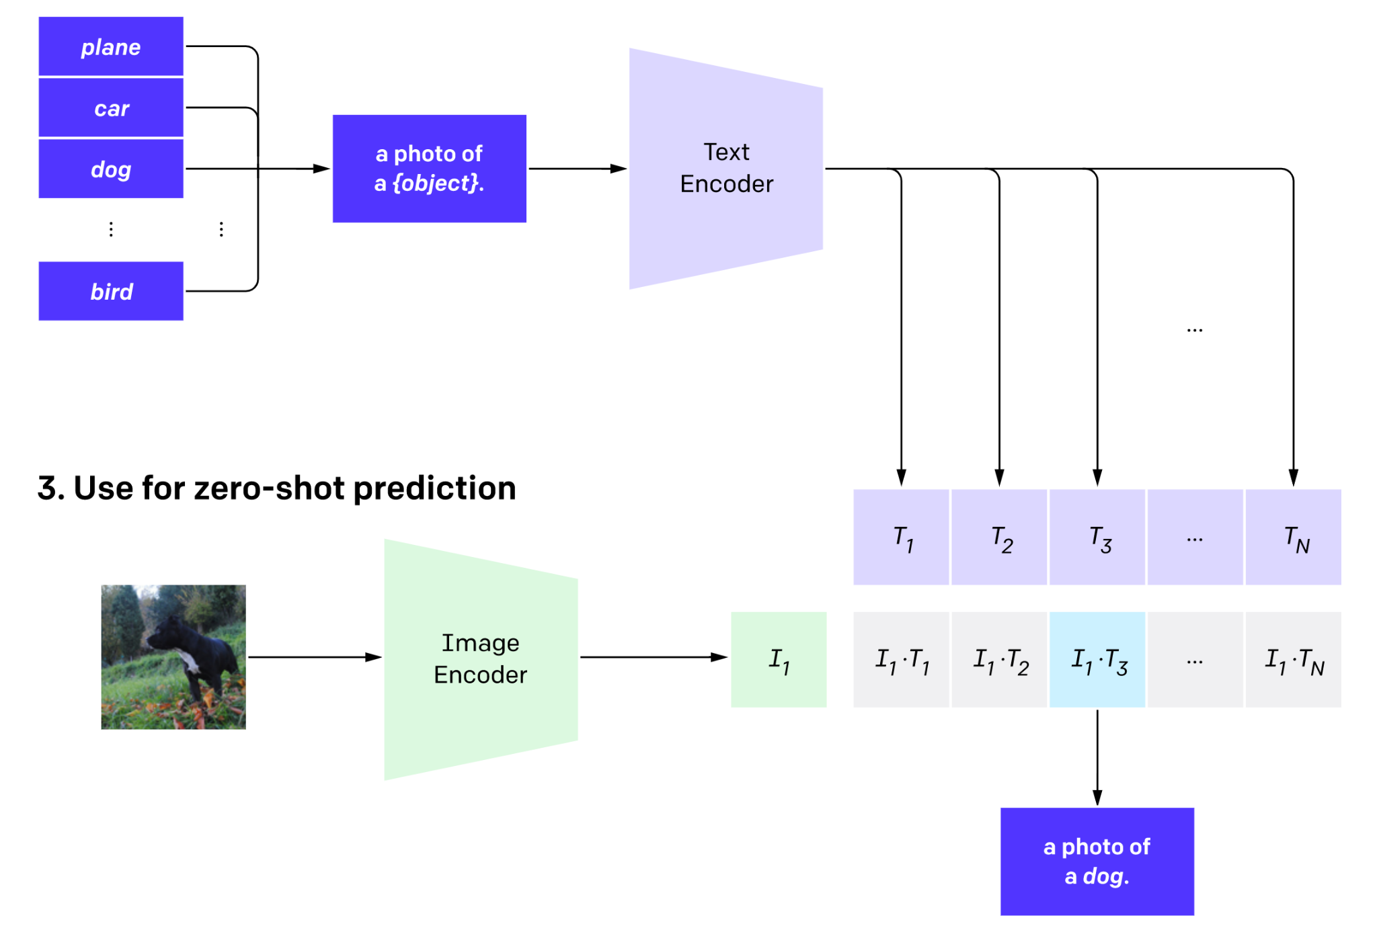
CLIP: Contrastive Language-Image Pre-training (Radford et al 2021)

Slide 56
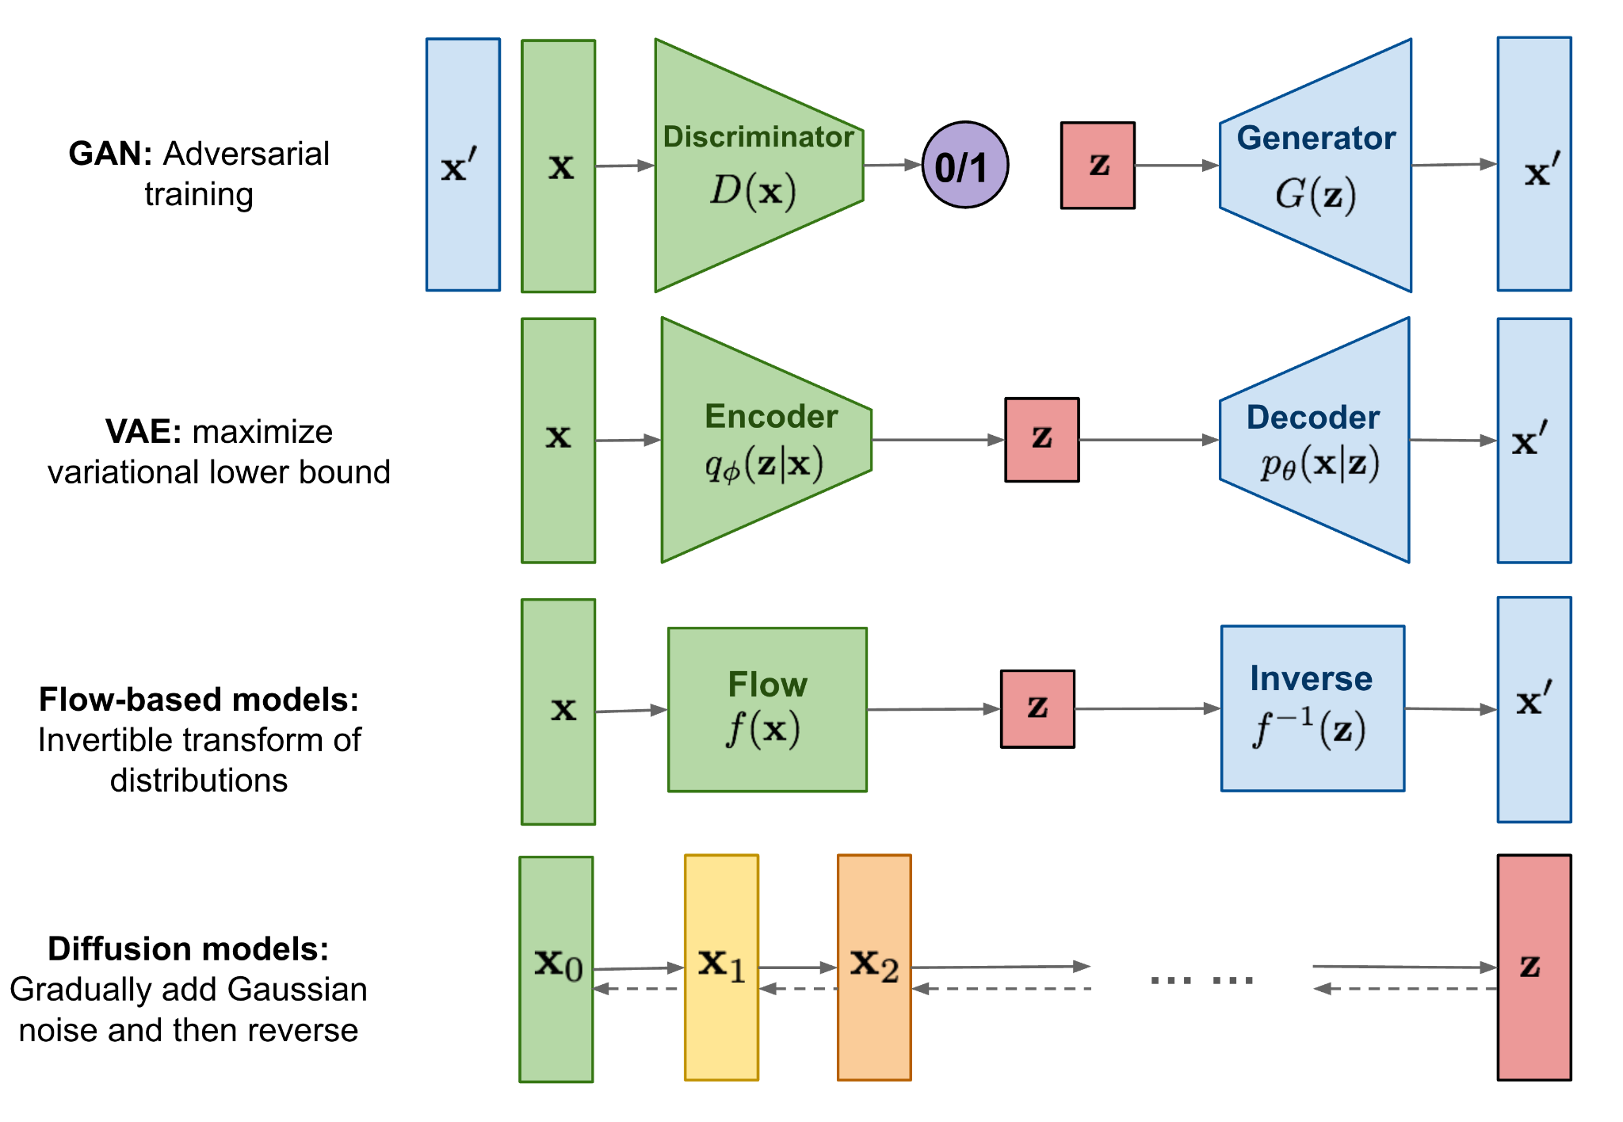
A New Generative Paradigm: Diffusion Models
*Image from https://lilianweng.github.io/posts/2021-07-11-diffusion-models/

Slide 57
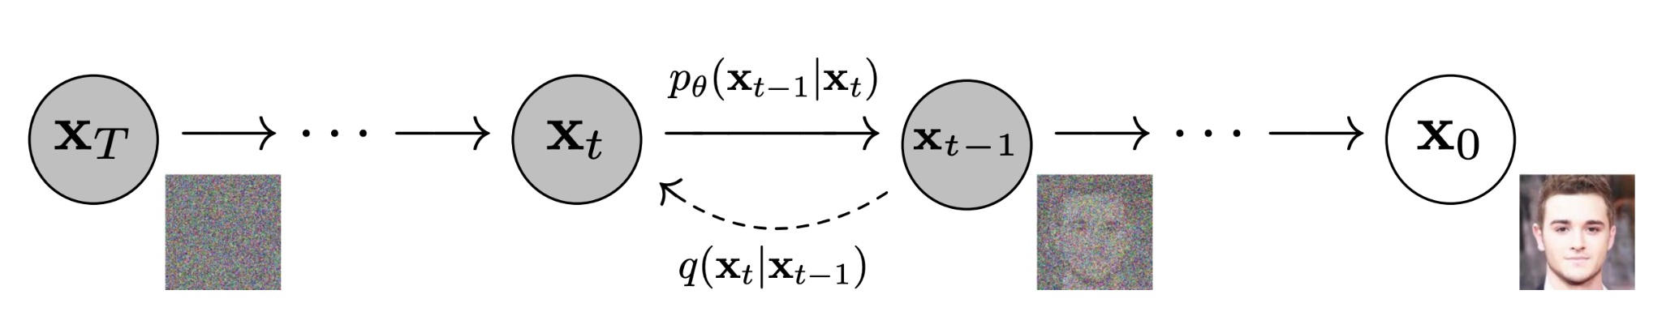
Diffusion Models
* Top image from (Ho et al 2021)
**2nd image from https://lilianweng.github.io/posts/2021-07-11-diffusion-models/

Slide 58
Diffusion Models
First add (gaussian noise over T steps)
* Top image from (Ho et al 2021)
**2nd image from https://lilianweng.github.io/posts/2021-07-11-diffusion-models/

Slide 59
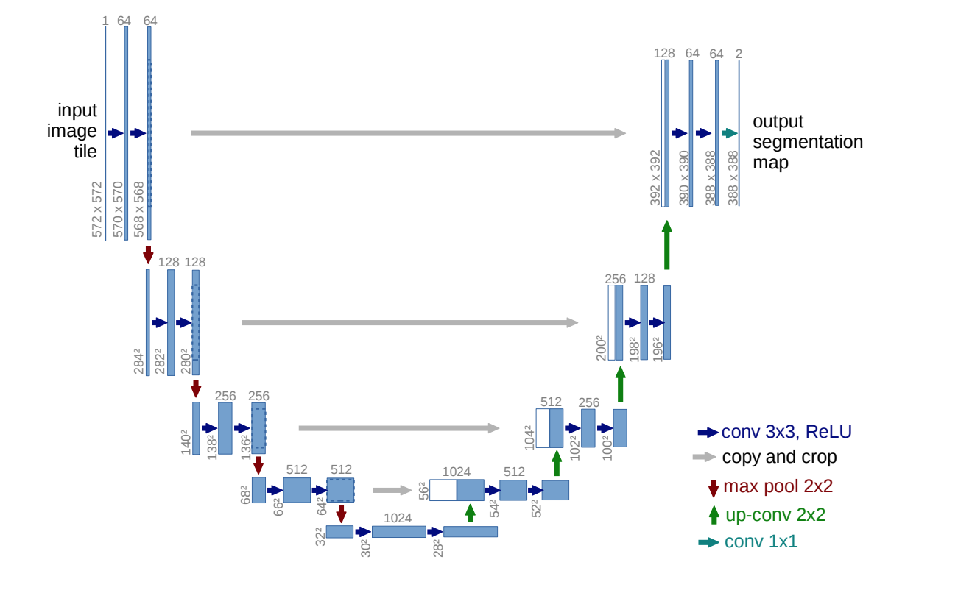
Diffusion Models
First add (gaussian noise over T steps)
Train the generator p_{𝞡} to reverse the process
- Typically a U-Net
- Includes text input
- Selective (text) Attention
- Text based classifier free guidance (hack)
Attn
Attn
Attn
Attn
Attn

Slide 60
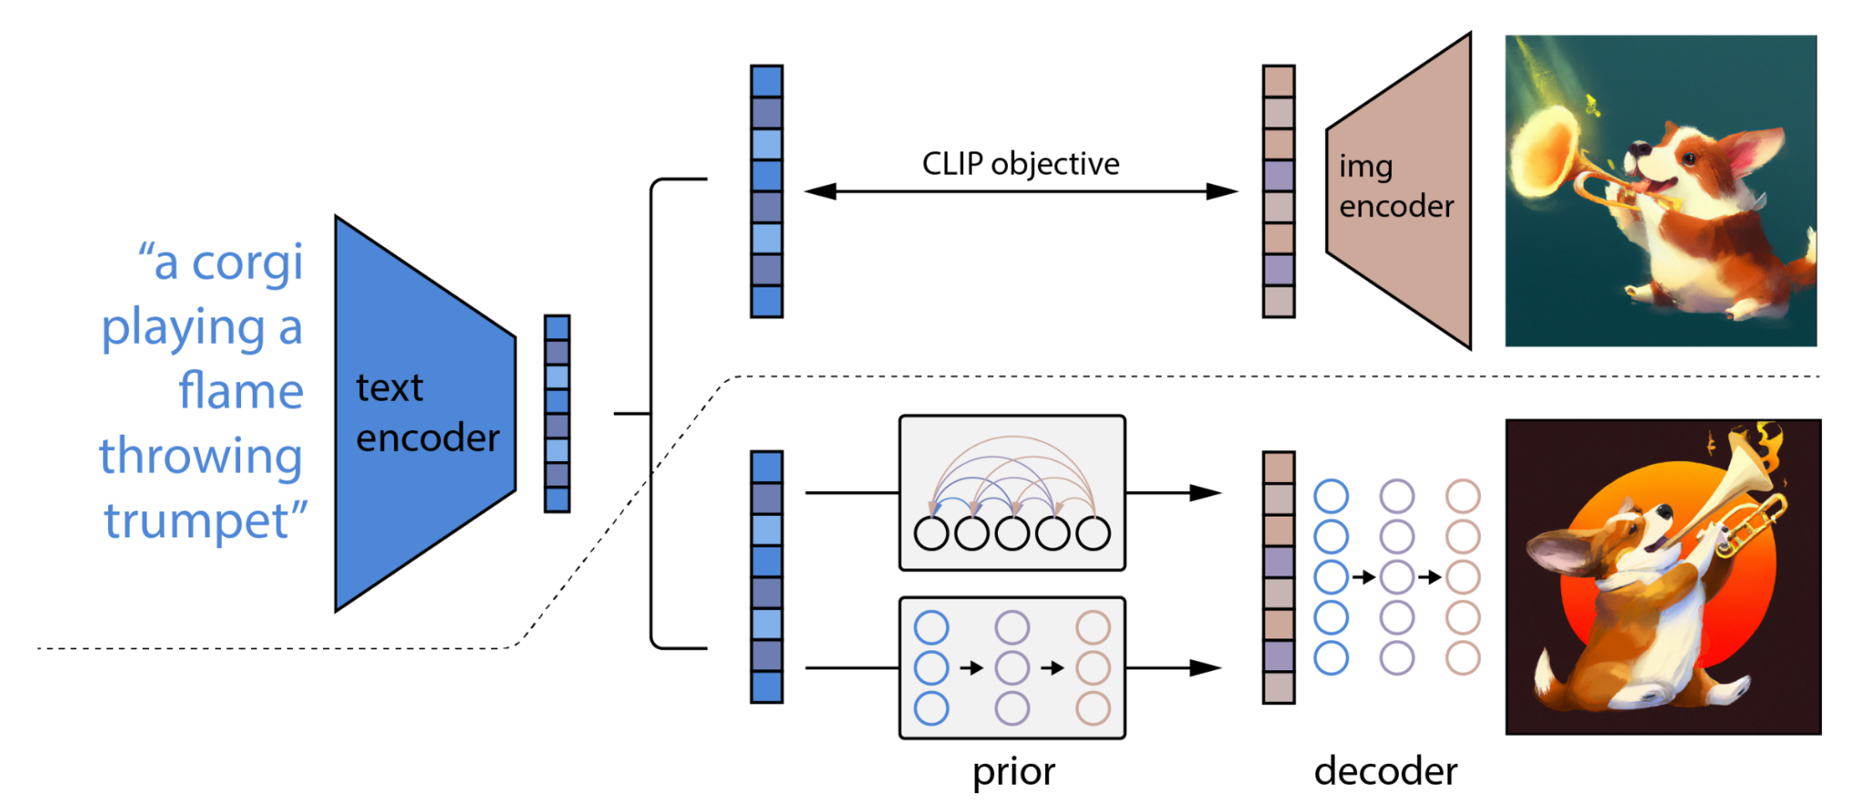
DALL·E 2 (“unCLIP” diagram)
Diffusion Models *w/classifier free guidance (Ho et al 2021;Nichol et al 2021)

Slide 61
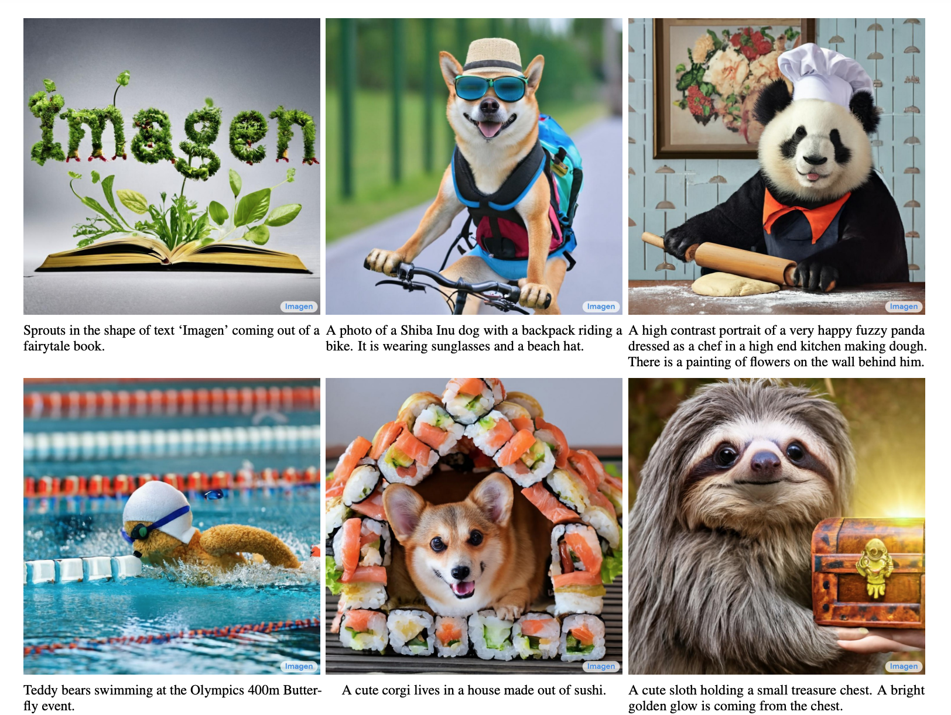
Imagen (Google)
Attn
Attn
Attn
Attn
Attn
Imagen U-Nets use FROZEN T5 embeddings in Input, Attn, & classifier free guidance (no CLIP!)

